Slide 1
Static Analysis – Perform Analysis
AVCDL-Implementation-7.1.2
Charles Wilson
Staff Product Cybersecurity Architect
version 4
2026-02-10
Notes:
Script:
I'm Charles Wilson, staff product cybersecurity architect at Torc Robotics.
This presentation will cover the Static Analysis Perform Analysis activity.

Slide 2
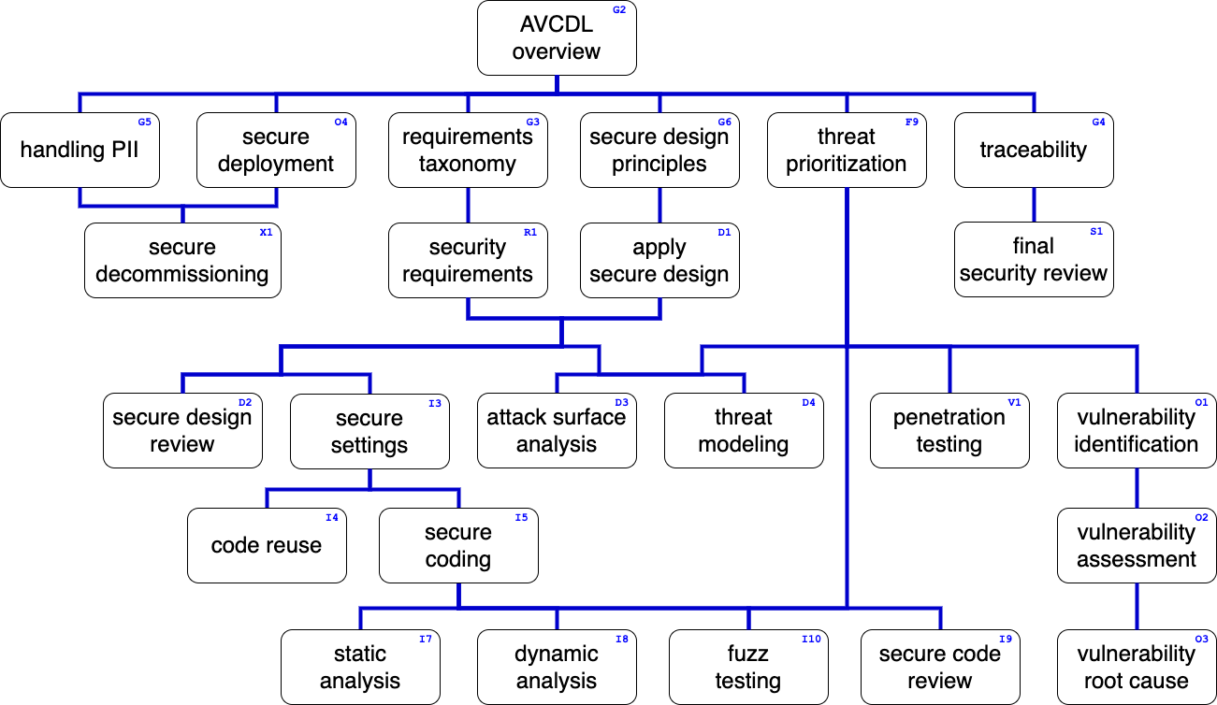
Training Path
Notes:
Script:
This diagram shows the overall AVCDL training path.
If you're taking this training, it's assumed that you've already completed the AVCDL Overview training,
and additionally, that you've completed the
Requirements Taxonomy
Security Requirements
Secure Design Principles
Apply Secure Design
Threat Prioritization
Secure Settings
Secure Coding
Static Analysis Overview
and
Static Analysis – Establish Settings
trainings.
This training will cover the Static Analysis Perform Analysis activity.

Slide 3
Workflow
Notes:
Script:
Before getting into how we perform the analysis, let's briefly review where it fits, in the overall static analysis process.

Slide 4
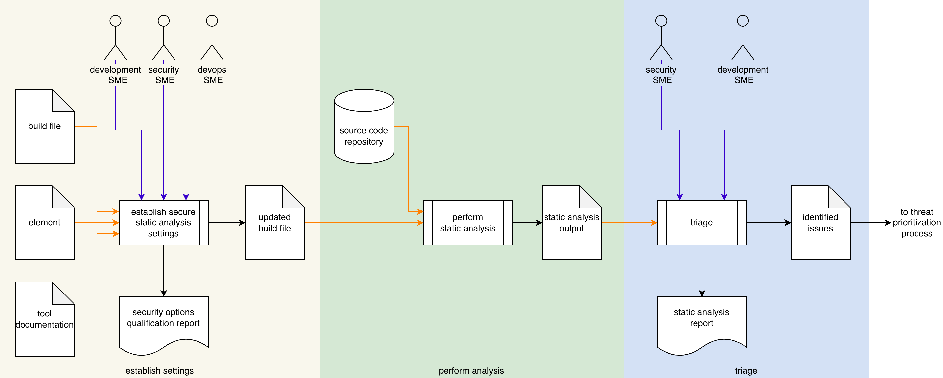
Process Workflow
Notes:
Script:
Here's the static analysis process which we previously covered in the Static Analysis Overview training.
[break]
Our focus for this training is going to be on the second activity, that of performing the analysis.

Slide 5
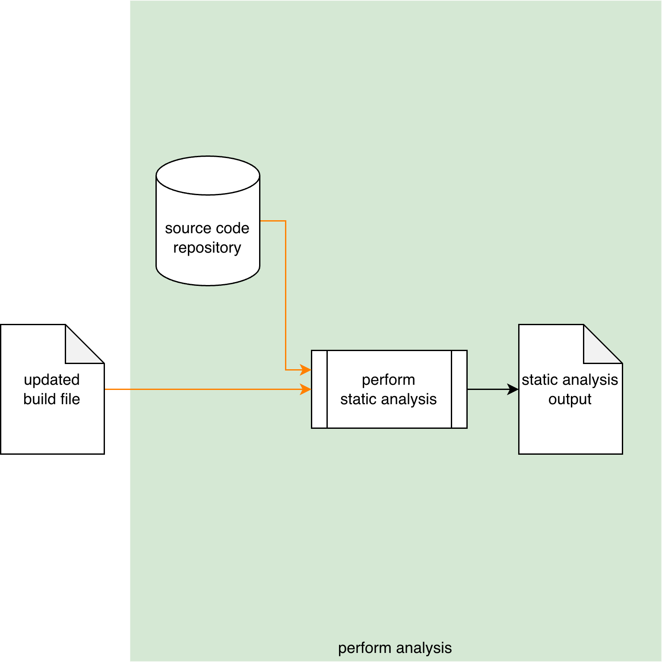
Process Workflow
Notes:
Script:
Here's the static analysis process which we previously covered in the Static Analysis Overview training.
[break]
Our focus for this training is going to be on the second activity, that of performing the analysis.

Slide 6
Perform Analysis Activity
JSON-encoded SARIF
Notes:
Script:
Drawing on
[pause]
the source code repository and using
[pause]
the settings specified in the updated build file,
[pause]
the static analysis tool performs a cybersecurity-focused static analysis of the element under consideration and
[pause]
generates output to a static analysis output file.
And as a note, it’s recommended that JSON-encoded SARIF be used for the output.

Slide 7
Runtime Considerations
Notes:
Script:
One might wonder, given that we've stated on multiple occasions that the analysis performance activity is hands-free, what the possible considerations could be.
Even given its automated nature, there are some things worth considering when performing static analysis.
Let’s look at those.

Slide 8
Considerations
Option interaction
Execution impact
Notes:
Script:
First let’s consider the impact on results due to
[pause]
option interaction.
As a reminder, options don't always act in isolation.
If you are dealing with a strict, rules-based analysis where every rule operates independently, then you're probably fine.
If you are dealing with a static analysis tool where there’s the possibility for interaction, say for instance, a compiler, you may have to adjust the options so that you're not getting unexpected outcomes.
These may be either a cascade of additional issues that you're not ready to address, or the absence of expected issues.
This is just the nature of using tools like compilers, which are intended to generate executable code, not be used for static analysis directly.
[pause]
The second thing to consider is the
[pause]
impact on the build process.
Because static analysis is such a resource intensive activity, there is a high likelihood that it will perturb the build process’ timing or storage use.
And so, the static analysis SME should work with devops to ensure that the build environment has enough headroom to be able to perform the static analysis activity.
This is true regardless of whether we're talking about a build on the developer’s machine or one on a dedicated build server.
Also, keep in mind that because stand-alone static analysis tools backed by databases keep historical results so they can compare not only across the entire body of the source code, but also across time, these tools have large storage needs.
[break]
The final aspect for consideration is the duality presented in the establish settings activity.
[pause]
We don't simply have static analysis running on the build machine against the integration branch.
[pause]
We have the case where we're using static analysis against the developer branch on the developer’s machine.
[pause]
We may also be using two different static analysis tools,
[pause]
or at least two different sets of settings.
We need to ensure that as settings changes are made over time, that they don’t get out of sync.

Slide 9
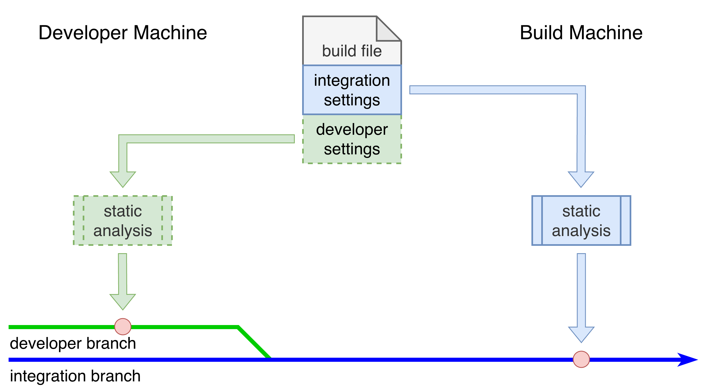
Considerations
Notes:
Script:
First let’s consider the impact on results due to
[pause]
option interaction.
As a reminder, options don't always act in isolation.
If you are dealing with a strict, rules-based analysis where every rule operates independently, then you're probably fine.
If you are dealing with a static analysis tool where there’s the possibility for interaction, say for instance, a compiler, you may have to adjust the options so that you're not getting unexpected outcomes.
These may be either a cascade of additional issues that you're not ready to address, or the absence of expected issues.
This is just the nature of using tools like compilers, which are intended to generate executable code, not be used for static analysis directly.
[pause]
The second thing to consider is the
[pause]
impact on the build process.
Because static analysis is such a resource intensive activity, there is a high likelihood that it will perturb the build process’ timing or storage use.
And so, the static analysis SME should work with devops to ensure that the build environment has enough headroom to be able to perform the static analysis activity.
This is true regardless of whether we're talking about a build on the developer’s machine or one on a dedicated build server.
Also, keep in mind that because stand-alone static analysis tools backed by databases keep historical results so they can compare not only across the entire body of the source code, but also across time, these tools have large storage needs.
[break]
The final aspect for consideration is the duality presented in the establish settings activity.
[pause]
We don't simply have static analysis running on the build machine against the integration branch.
[pause]
We have the case where we're using static analysis against the developer branch on the developer’s machine.
[pause]
We may also be using two different static analysis tools,
[pause]
or at least two different sets of settings.
We need to ensure that as settings changes are made over time, that they don’t get out of sync.

Slide 10
Recap
Notes:
Script:
That covers the perform analysis activity of the static analysis process.
Let's look at a summary.

Slide 11
Summary
Consider the build system impact
Keep the settings in sync
Use SARIF for output
Notes:
Script:
First and foremost, always consider the build system impact of static analysis.
It can't be overstated, that any disruption to the build system has a severe impact on the velocity of the development teams.
And so, It should be a priority to ensure that there is sufficient headroom for static analysis to perform.
[pause]
Next, if your organization is using multiple static analysis option sets, say one set of for the integration branch, another for the developer branch, or different tools for the build and developer machines,
[pause]
that you need to be sure that you're keeping these settings in sync.
Finally, use SARIF for output when it's feasible.
This is a kind of a future proofing as JSON-encoded SARIF is easily processed by Python.
This allows you to ingest it into issue tracking systems.
It also can be used as feedback directly into various IDEs to facilitate mitigation by the developers themselves.

Slide 12
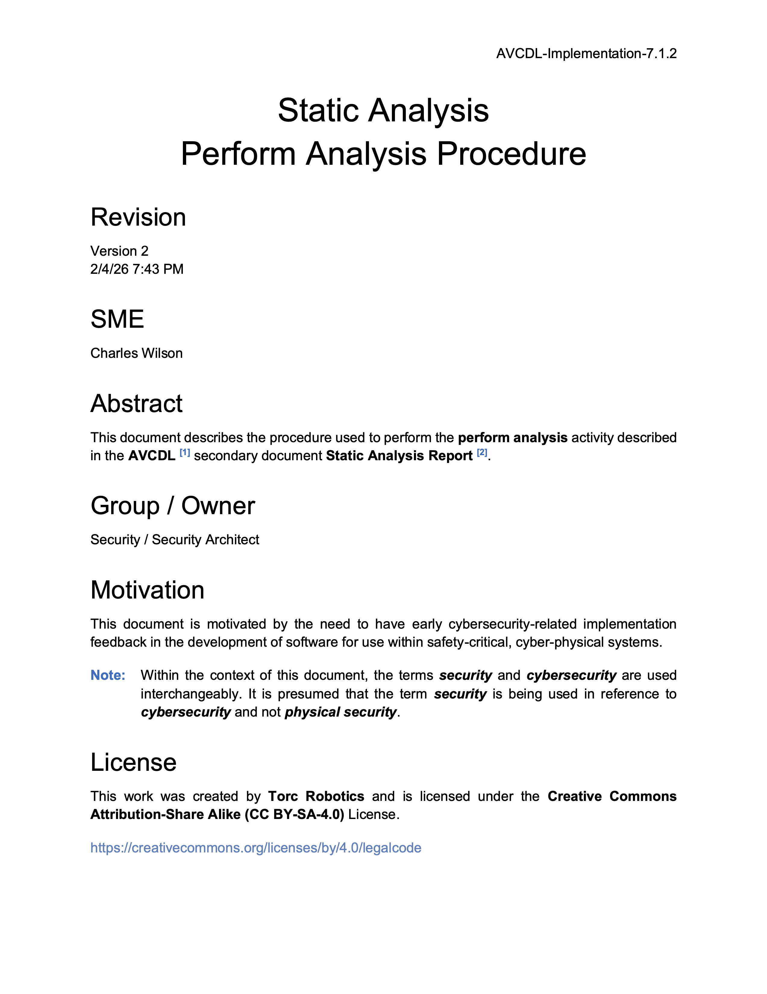
Further Reading
Notes:
Script:
For additional information and to get a more in-depth set of references, the Static Analysis Perform Analysis Procedure tertiary document is available in the AVCDL GitHub repository.

Slide 13
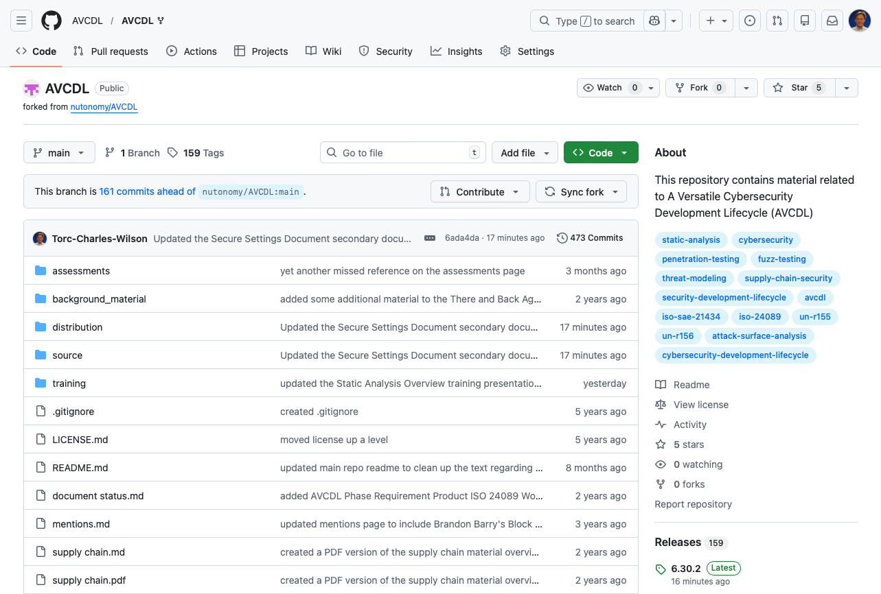
AVCDL on GitHub
https://github.com/AVCDL/AVCDL
Notes:
Script:
All AVCDL materials, both in source and distribution forms, are available on our GitHub site, as shown here.
Because of the size of the repository, it's recommended that you either clone the repository or download a ZIP archive of it, if you're not familiar with using git.
Instructions for downloading a ZIP archive are linked to on the repository’s front page.

Slide 14
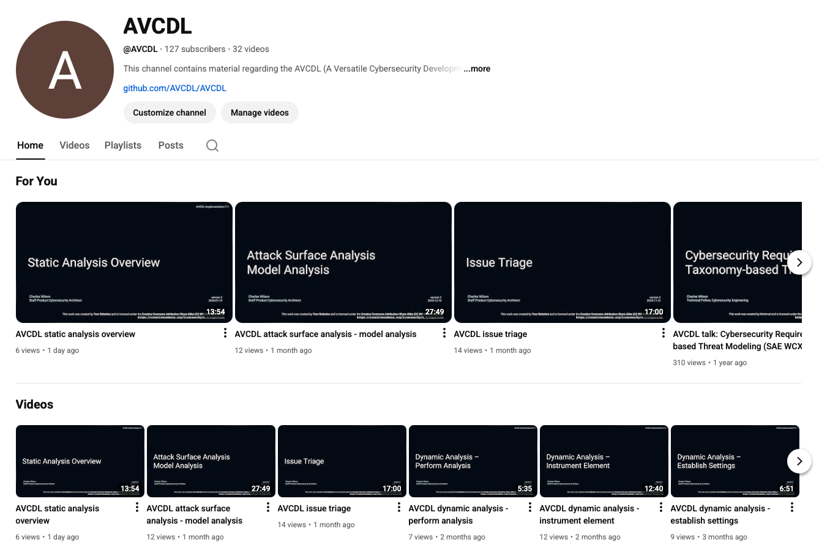
AVCDL on YouTube
https://youtube.com/@AVCDL
Notes:
Script:
Videos covering various aspects of the AVCDL are available on our YouTube channel, as shown here.
It's important to note that all AVCDL materials with the exception of the introductory blog posts are intended for product cybersecurity engineering practitioners.

Slide 15
Next Steps
Notes:
Script:
With this training complete, if you’ve completed the other trainings covering the Static Analysis process activities, you can proceed to the other training at this level, these include:
Dynamic Analysis
Fuzz Testing
and
Secure Code Review

Slide 16
References
AVCDL primary document
Static Analysis Report (AVCDL secondary document)
Static Analysis – Perform Analysis Procedure (AVCDL tertiary document)
Secure Settings – Apply Options Procedure (AVCDL tertiary document)
Static Analysis Results Interchange Format (SARIF) Version 2.1.0
https://docs.oasis-open.org/sarif/sarif/v2.1.0/os/sarif-v2.1.0-os.pdf
Notes:
Script:
Here are the references to the source material used in the creation of this presentation.
They'll also be included in the video description.
Additionally, this presentation’s source material will be provided on the AVCDL GitHub repository.

